Slide 1
Unequal experiences of health/disease, and different opportunities for Hispanics Before, during and after the COVID-19 pandemic
Gerardo Maupome, Richard M. Fairbanks School of Public Health

Slide 2
Some features of Hispanic community
Fastest growing ethnic minority in the US (about 60 million) in 2019
491,436 in Indiana (7.3% of state population) in 2019
Heterogeneous population group, with multiple cultural traditions
Tend to be younger than other ethnic/racial groups (60% < 44 years old)
About 20% have less than high school education (IN and US)
About 40% make less than $50k/yr (2014)
Important pool of talent and large workforce, often in essential positions
Some of the worst health, social, and well-being outcomes associated with COVID-19

Slide 3
Nat’l Acad Sci Engineering & Medicine
Early evidence indicated that COVID-19 was impacting communities of color at much higher rates than the others
This trend has worsened as the pandemic unfolds
This example of health inequity arises from causes clustered in:
structural inequities in distribution of power across boundaries of race, gender, social class, sexual orientation, etc.
unequal allocation of resources—including goods and services—which manifests in disparate social, economic, and environmental conditions
Ensemble of factors are often called social determinants of health

Slide 4
Syndemic
Singer et al. in the 1990s: syndemic is not just epidemic nor pandemic
Syndemics are built upon biological and social interactions between conditions and states: interactions increase susceptibility to harm and worsen health outcomes
Biological and social interactions are important for disease diagnosis, treatment, health policy, etc.
Addressing impacts of COVID-19 demands far greater attention to socioeconomic inequality
Large collection of pre-existing issues!

Slide 5
Common risk factor
Maria and Juan live in West 38th
Maria works 3 jobs during the week, and might soon lose one
Juan has 2 older siblings in high school; they help the household with small income they get from odd jobs here and there
Maria is diabetic. Food insecurity is a persistent problem at home, and family maximizes calorie intake to avoid hunger
Juan has missed school days because of a toothache, or poor sleep
Accessing health care services is problematic. Where to go and how to pay?

Slide 6
Substantial need 2020
Example: La Plaza community organization
Emergency assistance: 329 families for rent, 262 for utilities
Food boxes 2020, until Feb 2021: 13,663. 100-200 cars in line on Fridays
Reach for Youth counseling, or referrals: 500+
Domestic Violence program: 186 clients last 24 months
Thanksgiving supplies: about 250 per year last 24 months
Programs for Christmas toys: about 290 per year last 24 months

Slide 7
Talent and community life affected by COVID-19
Background
Our IU group has several lines of research – planned, completed and ongoing:
Mapping peer networks – helping or undermining health outcomes?
First Indiana-wide cancer survey for Hispanics
Characterizing social, economic, health and well-being impacts from COVID-19
Attitudes and perceptions about COVID-19 vaccines
Finding and using health information – printed, e-media, etc.

Slide 8
Our practical research with Hispanic groups
Features
Primarily pragmatic, real life applications
Strong community partnerships coupled with rigorous scientific inquiry
Reliance on quantifiable metrics
Community outreach efforts based on hard data:
One example: focus groups → survey →
informant interviews → advisory panel = navigation manual
for dental care
Keep building on current network of
community allies!

Slide 9
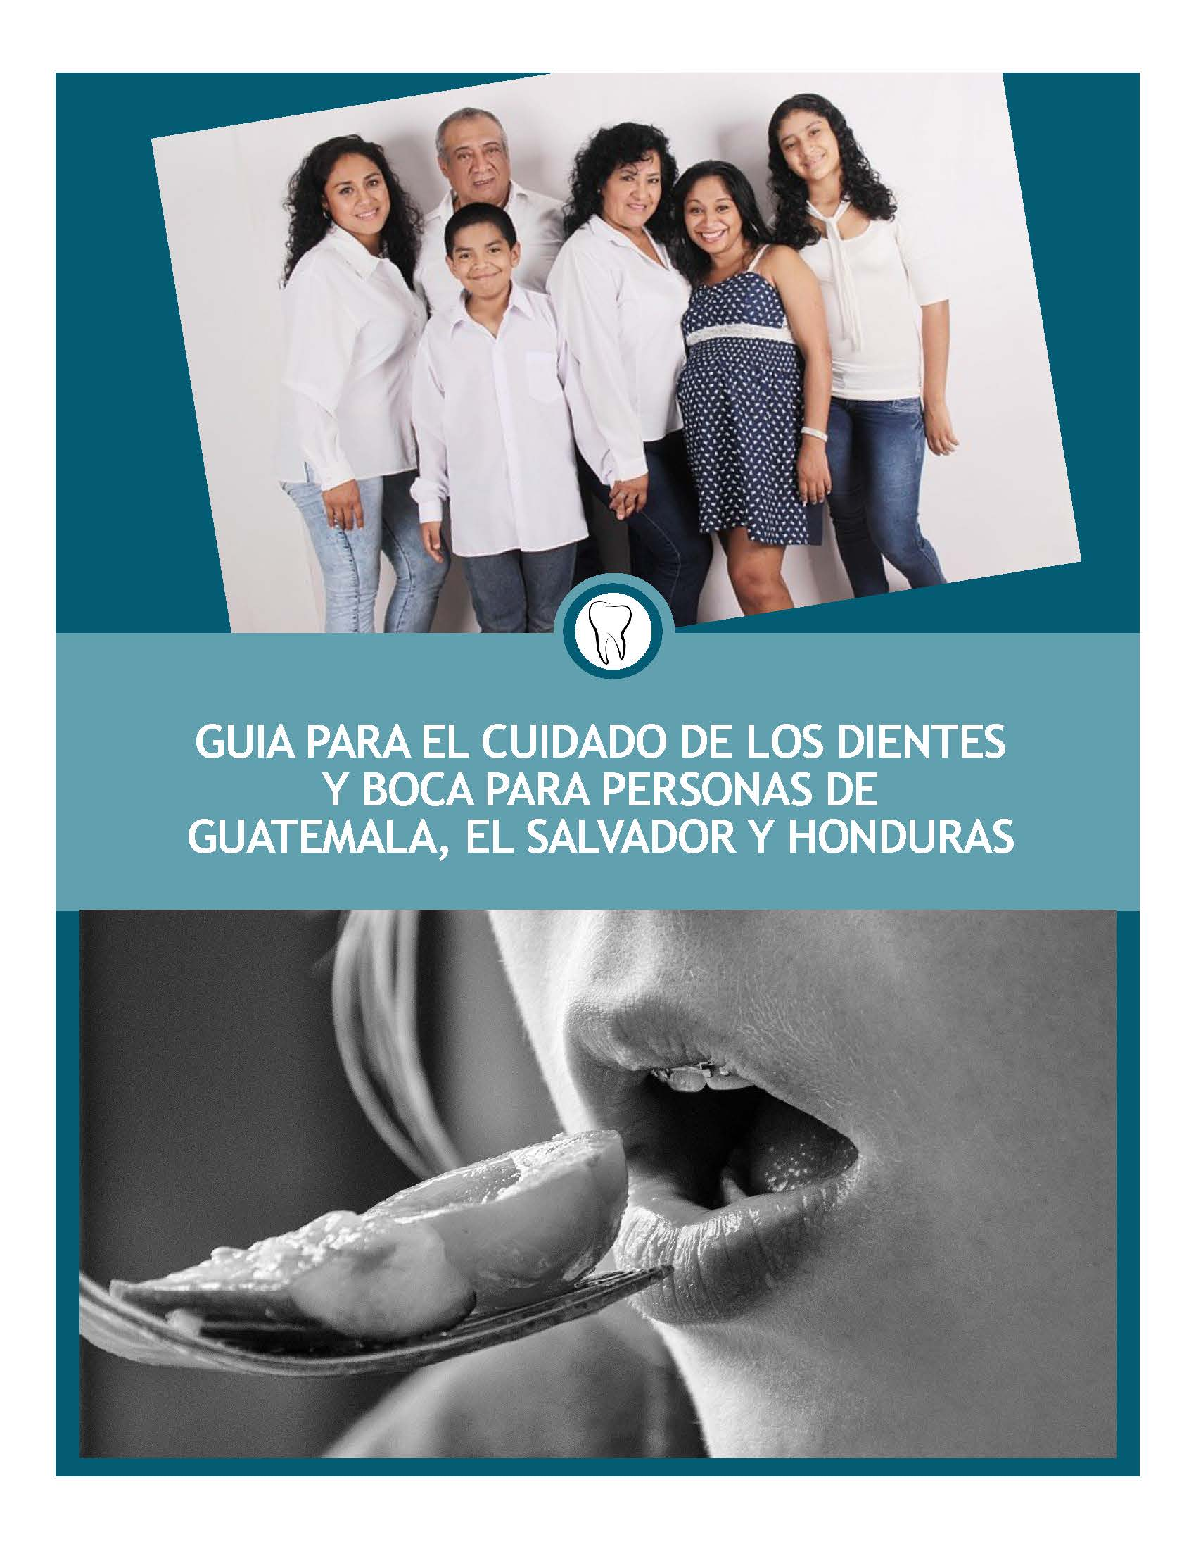
Our practical research with Hispanic groups
Features
Primarily practical, real life applications
Strong community partnerships coupled with rigorous scientific inquiry
Reliance on quantifiable metrics
Community outreach efforts based on hard data:
One example: focus groups → survey →
informant interviews → advisory panel = navigation manual
for dental care
Keep building on current network of
community allies!

Slide 10
Vision
We propose creating a virtual center – no bricks & mortar
Center acting as a tent to gather information, disseminate programs, optimize resources, and coordinate efforts throughout Indiana
Center is separate from research funding cycles and constraints
Hire staff and support community agents
Assets attained over past 10+ years:
Intimate connection with community stakeholders, organizations, and media
Brand recognition and wide connections throughout the state
Create a professional and lay member advisory panel to evaluate results

Slide 11
Who would be in the tent?
IU units – perhaps other universities, such as Purdue or Marian?
Churches and temples in Indiana
Mexican consulate (only Latin American consulate in the state)
Health systems outreach offices (Eskenazi, etc.)
Community organizations in Indiana (Hispanic-focused and other)
Hispanic-owned businesses, and businesses catering to Hispanic clientele (eg, Walmart)
Employers (eg, Morales Group)
Other?

Slide 12
Goals of the Center
Protect talent by promoting healthful choices, preserving health, supporting health literacy, and connecting with healthcare resources
Navigation support for health opportunities, and for healthcare resources
Identify innovative and culturally-appropriate design, marketing, and promotion of health messaging (print, internet, text, other)
Themes:
Dietary choices and opportunities, with special focus on excess weight and high calorie intake. Chronic diseases
Mental health self-care and services. Health education, domestic violence, depression, stress

Slide 13
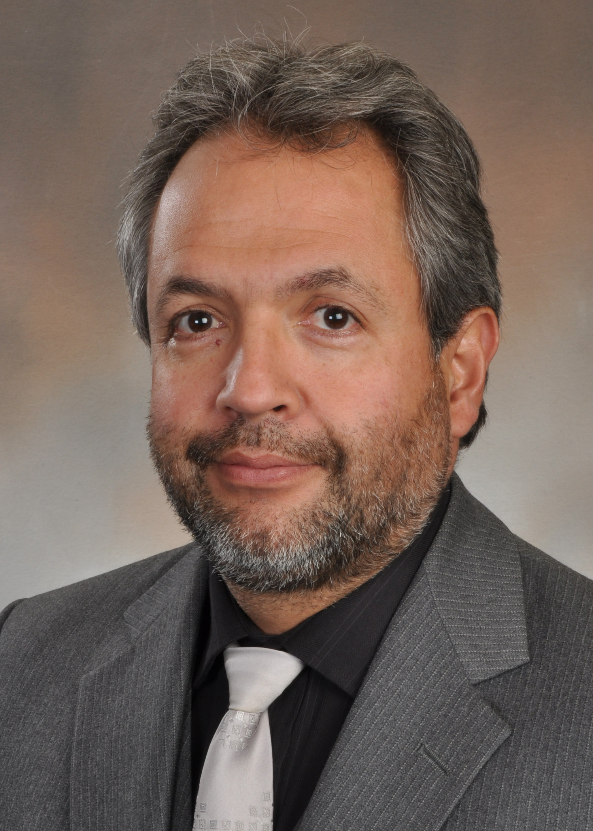
Many thanks for your time!
Questions?
Comments?
Gerardo Maupome
gmaupome@iu.edu
317-274-5529

